Slide 1
UCMJ Navy E-Learning App
Wireframes
2.12.16
Wireframes arrange elements to best accomplish a particular purpose. The purpose is usually being informed by business objectives and a creative approach. Wireframes typically lack typographic style, color, or graphics, since the main focus lies in functionality, behavior, and priority of content.
In other words, it focuses on what a screen does, not what it looks like.
All content is notional.

Slide 2
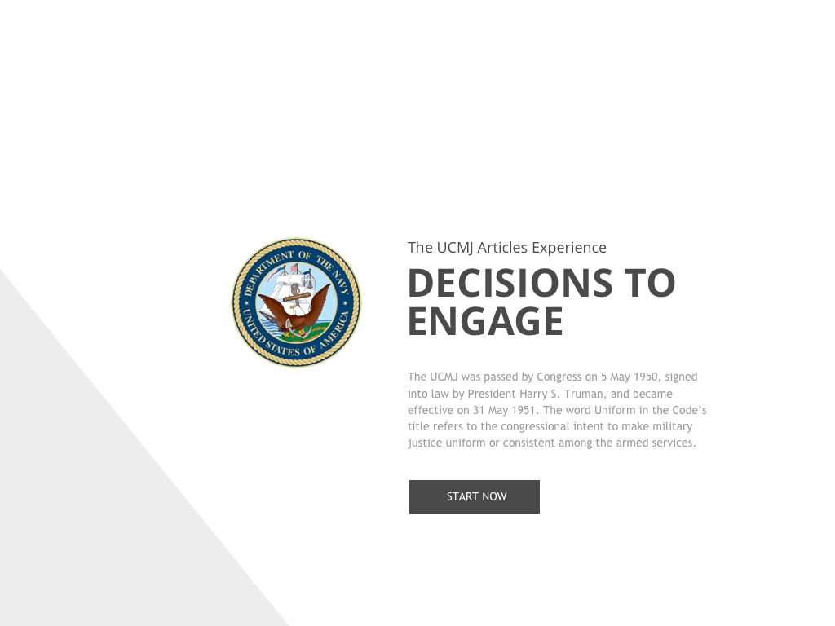
Splash Page
Tablet (landscape)
UCMJ Recruit Primer
What do we want to call this App?
This may end up being a true splash screen with no interaction and limited text (possibly the version number). Most of this content is in the about.
UCMJ Articles

Slide 3
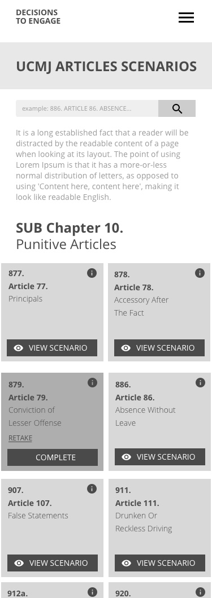
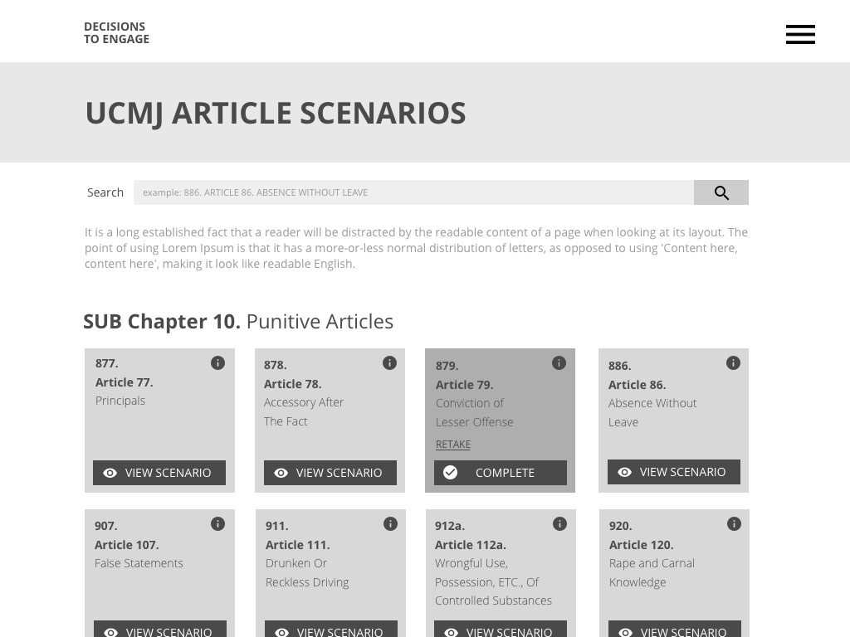
Article Scenarios Page
Reference
About
Tablet (landscape)
Phone (portrait)
Reference
About
User will
be directed
to “Reference”
section of
the App, but can go there at any time using top navigation.

Slide 4
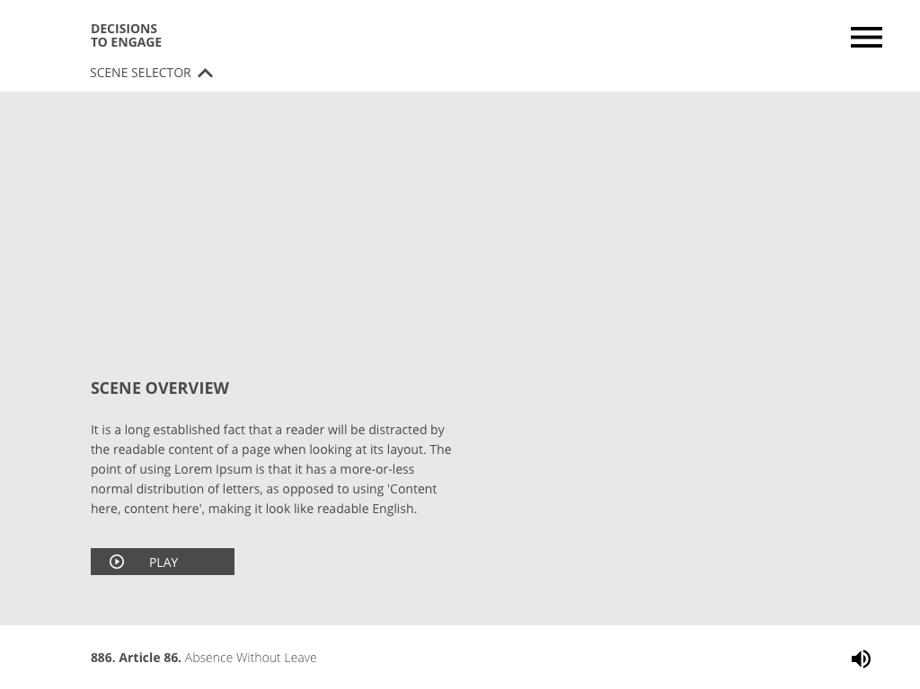
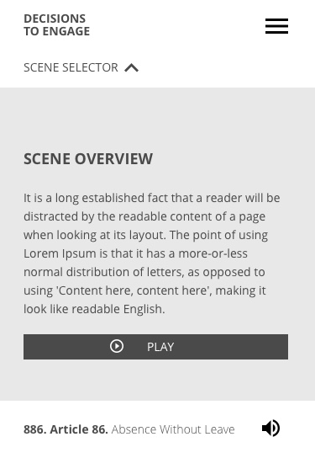
921. Article 121. Larceny and Wrongful Appropriation - Entry Page
Tablet
Phone
Reference
About
Would include an appropriate background image (thoughts?).
Reference
About

Slide 5
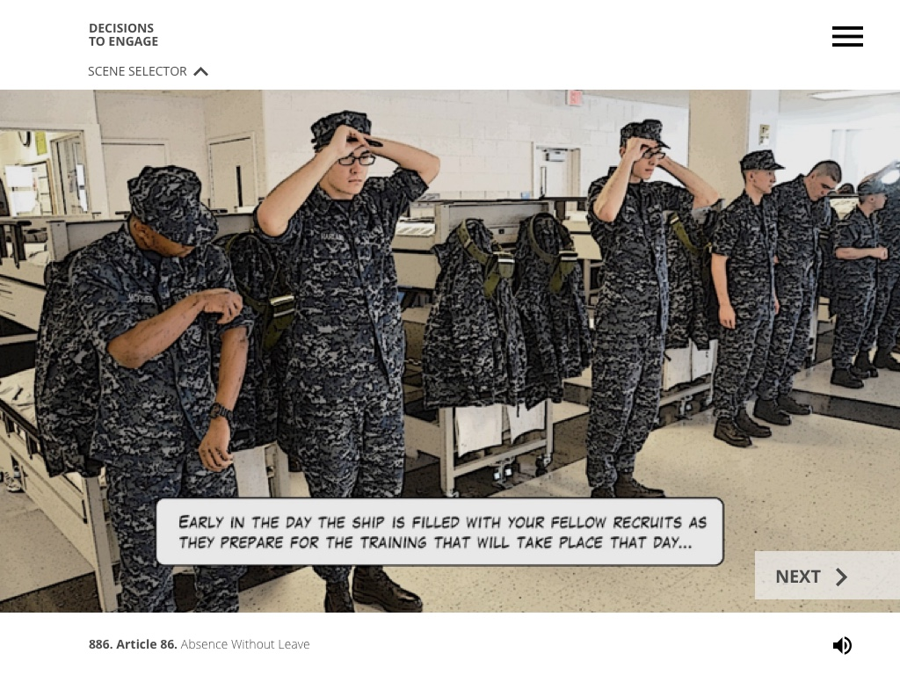
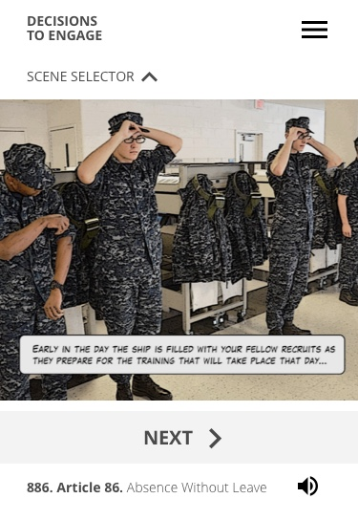
921. Article 121. Larceny and Wrongful Appropriation - Scene 1
Tablet
Phone
Reference
About
Note: The overlay text will need to be separated from the image so it can be truncated for mobile.
Reference
About

Slide 6
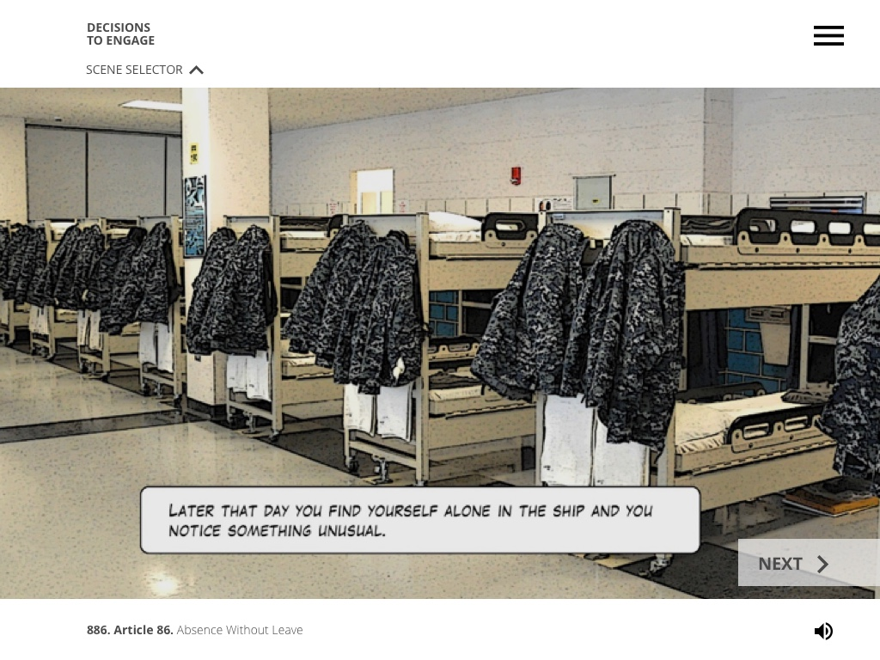
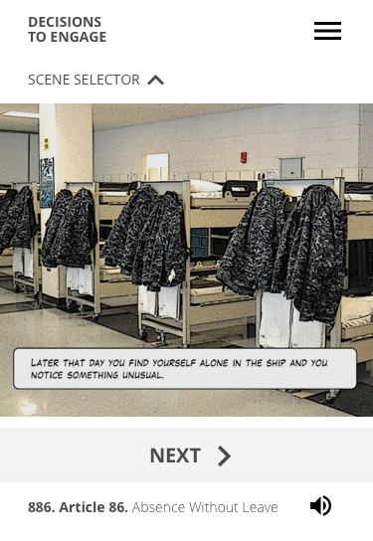
921. Article 121. Larceny and Wrongful Appropriation - Scene 2
Tablet
Phone
Reference
About
Reference
About

Slide 7
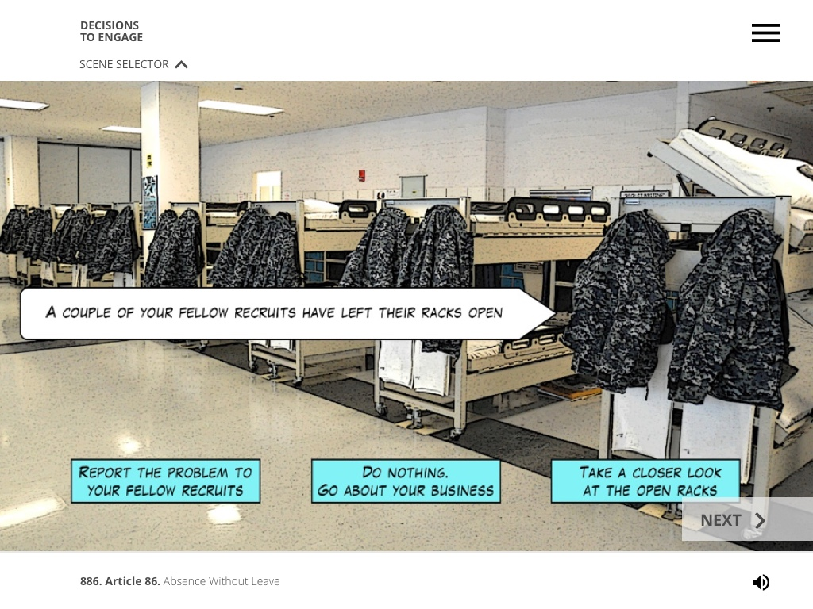
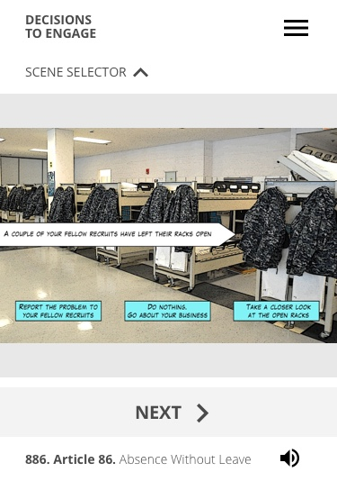
921. Article 121. Larceny and Wrongful Appropriation - Scene 3
Tablet
Phone
Reference
About
Reference
About

Slide 8
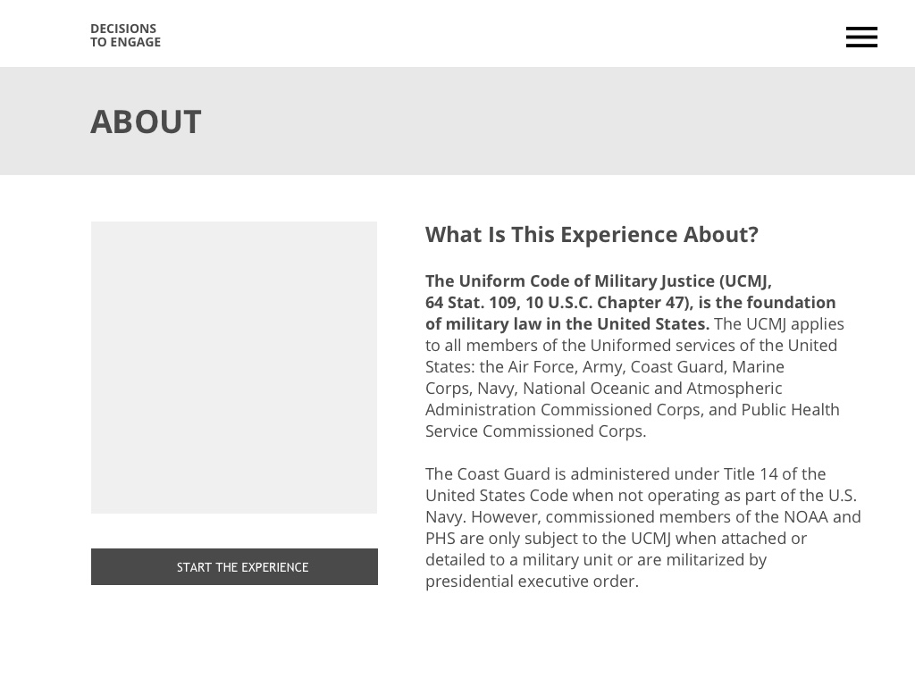
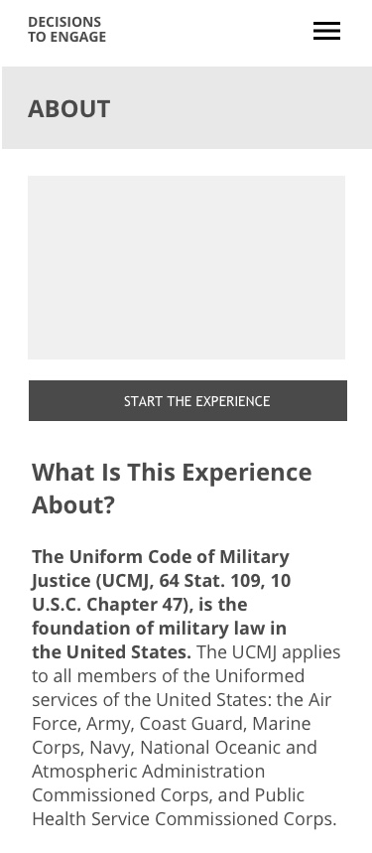
About Page
Tablet
Phone
Reference
About
Reference
About

